Slide 1
PERSONAL HABITS
Good personal habits including good eating habits, practicing personal reflection, not getting addicted to alcohol, drugs, tobacco products, getting enough sleep, volunteering , creating a success circle, being with positive peer, encouraging reading habits, indulging creativity, listening to music, helps in developing an individual into successful being.

Slide 2
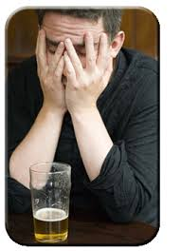
ALCOHOLISM
Alcohol is a very powerful, addictive drug that some adults enjoy in low doses, but that is damaging or even lethal in high doses. Many adults drink moderately and safely. For teens, alcohol can be very harmful - and it's illegal

Slide 3
What are the symptoms and signs of alcohol intoxication?
Smell of alcohol on their breath or skin
Glazed or bloodshot eyes
The person being unusually passive or argumentative
Deterioration in the person's appearance or hygiene
Flushed skin and memory loss.

Slide 4
WHAT HAPPENS DURING ALCOHOL INTAKE?
The alcohol enters your bloodstream from your stomach and small intestine. it travels to the brain. There, it slows reaction time, makes you less coordinated, impairs your vision, and - even at relatively low doses -- leads to unclear thinking and problems making good judgments.

Slide 5
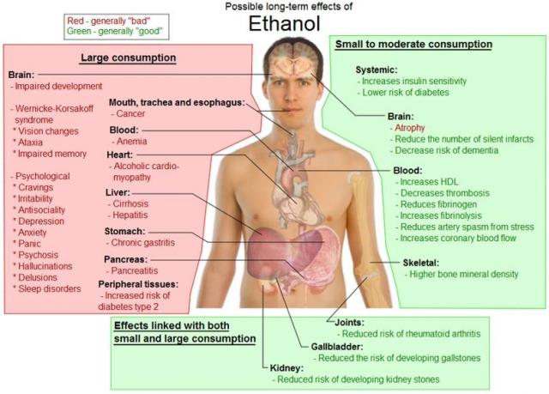

Slide 6
Reasons for Alcohol addiction
To improve their mood
To receive social rewards
To reduce negative feelings
To avoid social rejection.

Slide 7
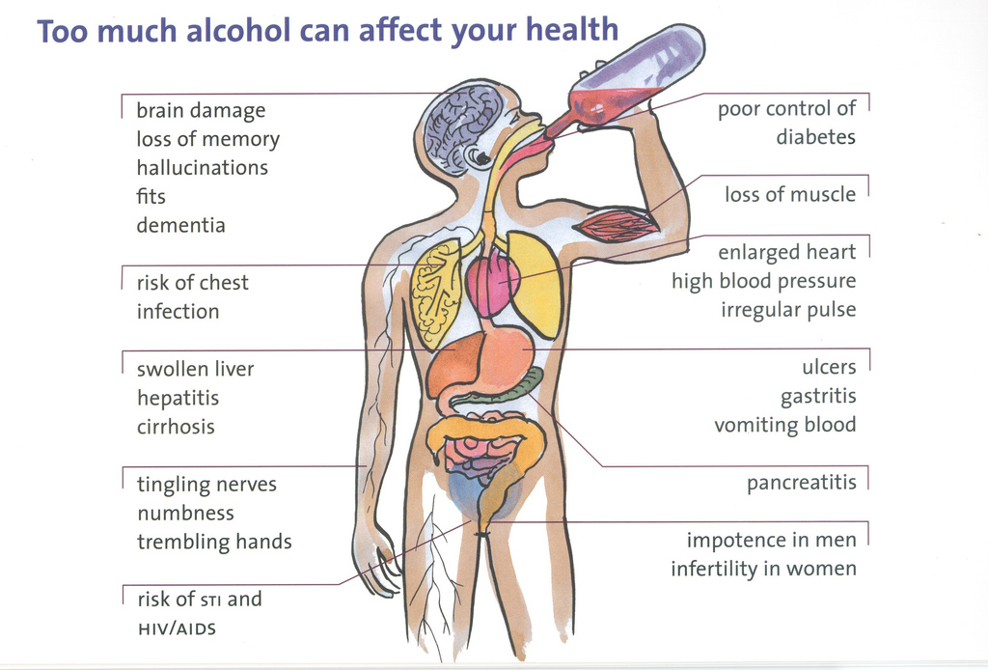

Slide 8
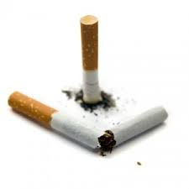
SMOKING AND ITS EFFECTS ON HEALTH
Smoking is a practice in which a substance is burned and the resulting smoke breathed in to be tasted or inhaled. Most commonly the substance is the dried leaves of the tobacco plant which has been rolled into rice paper into a small, round cylinder called a "cigarette".

Slide 9
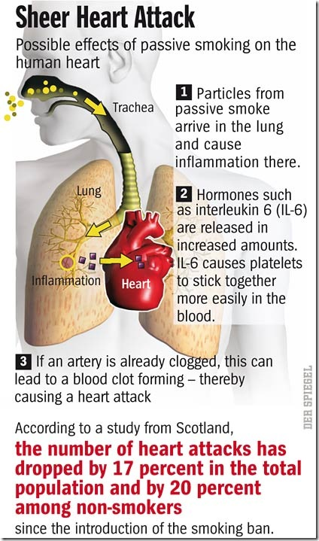
EFFECTS ON HUMAN HEALTH

Slide 10
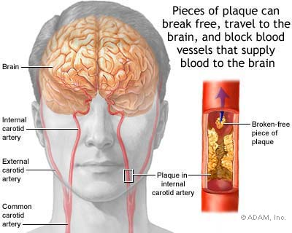

Slide 11

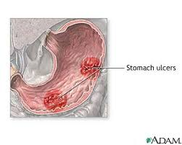
Research has shown that if a person regularly smokes 10 cigarettes a day, is one and a half times more likely to develop kidney cancer compared with a non-smoker. This is increased to twice as likely if a person smokes 20 or more cigarettes a day.

Slide 12
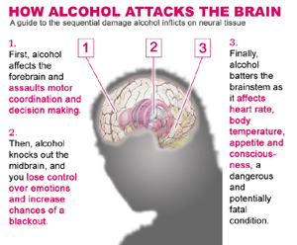

Slide 13
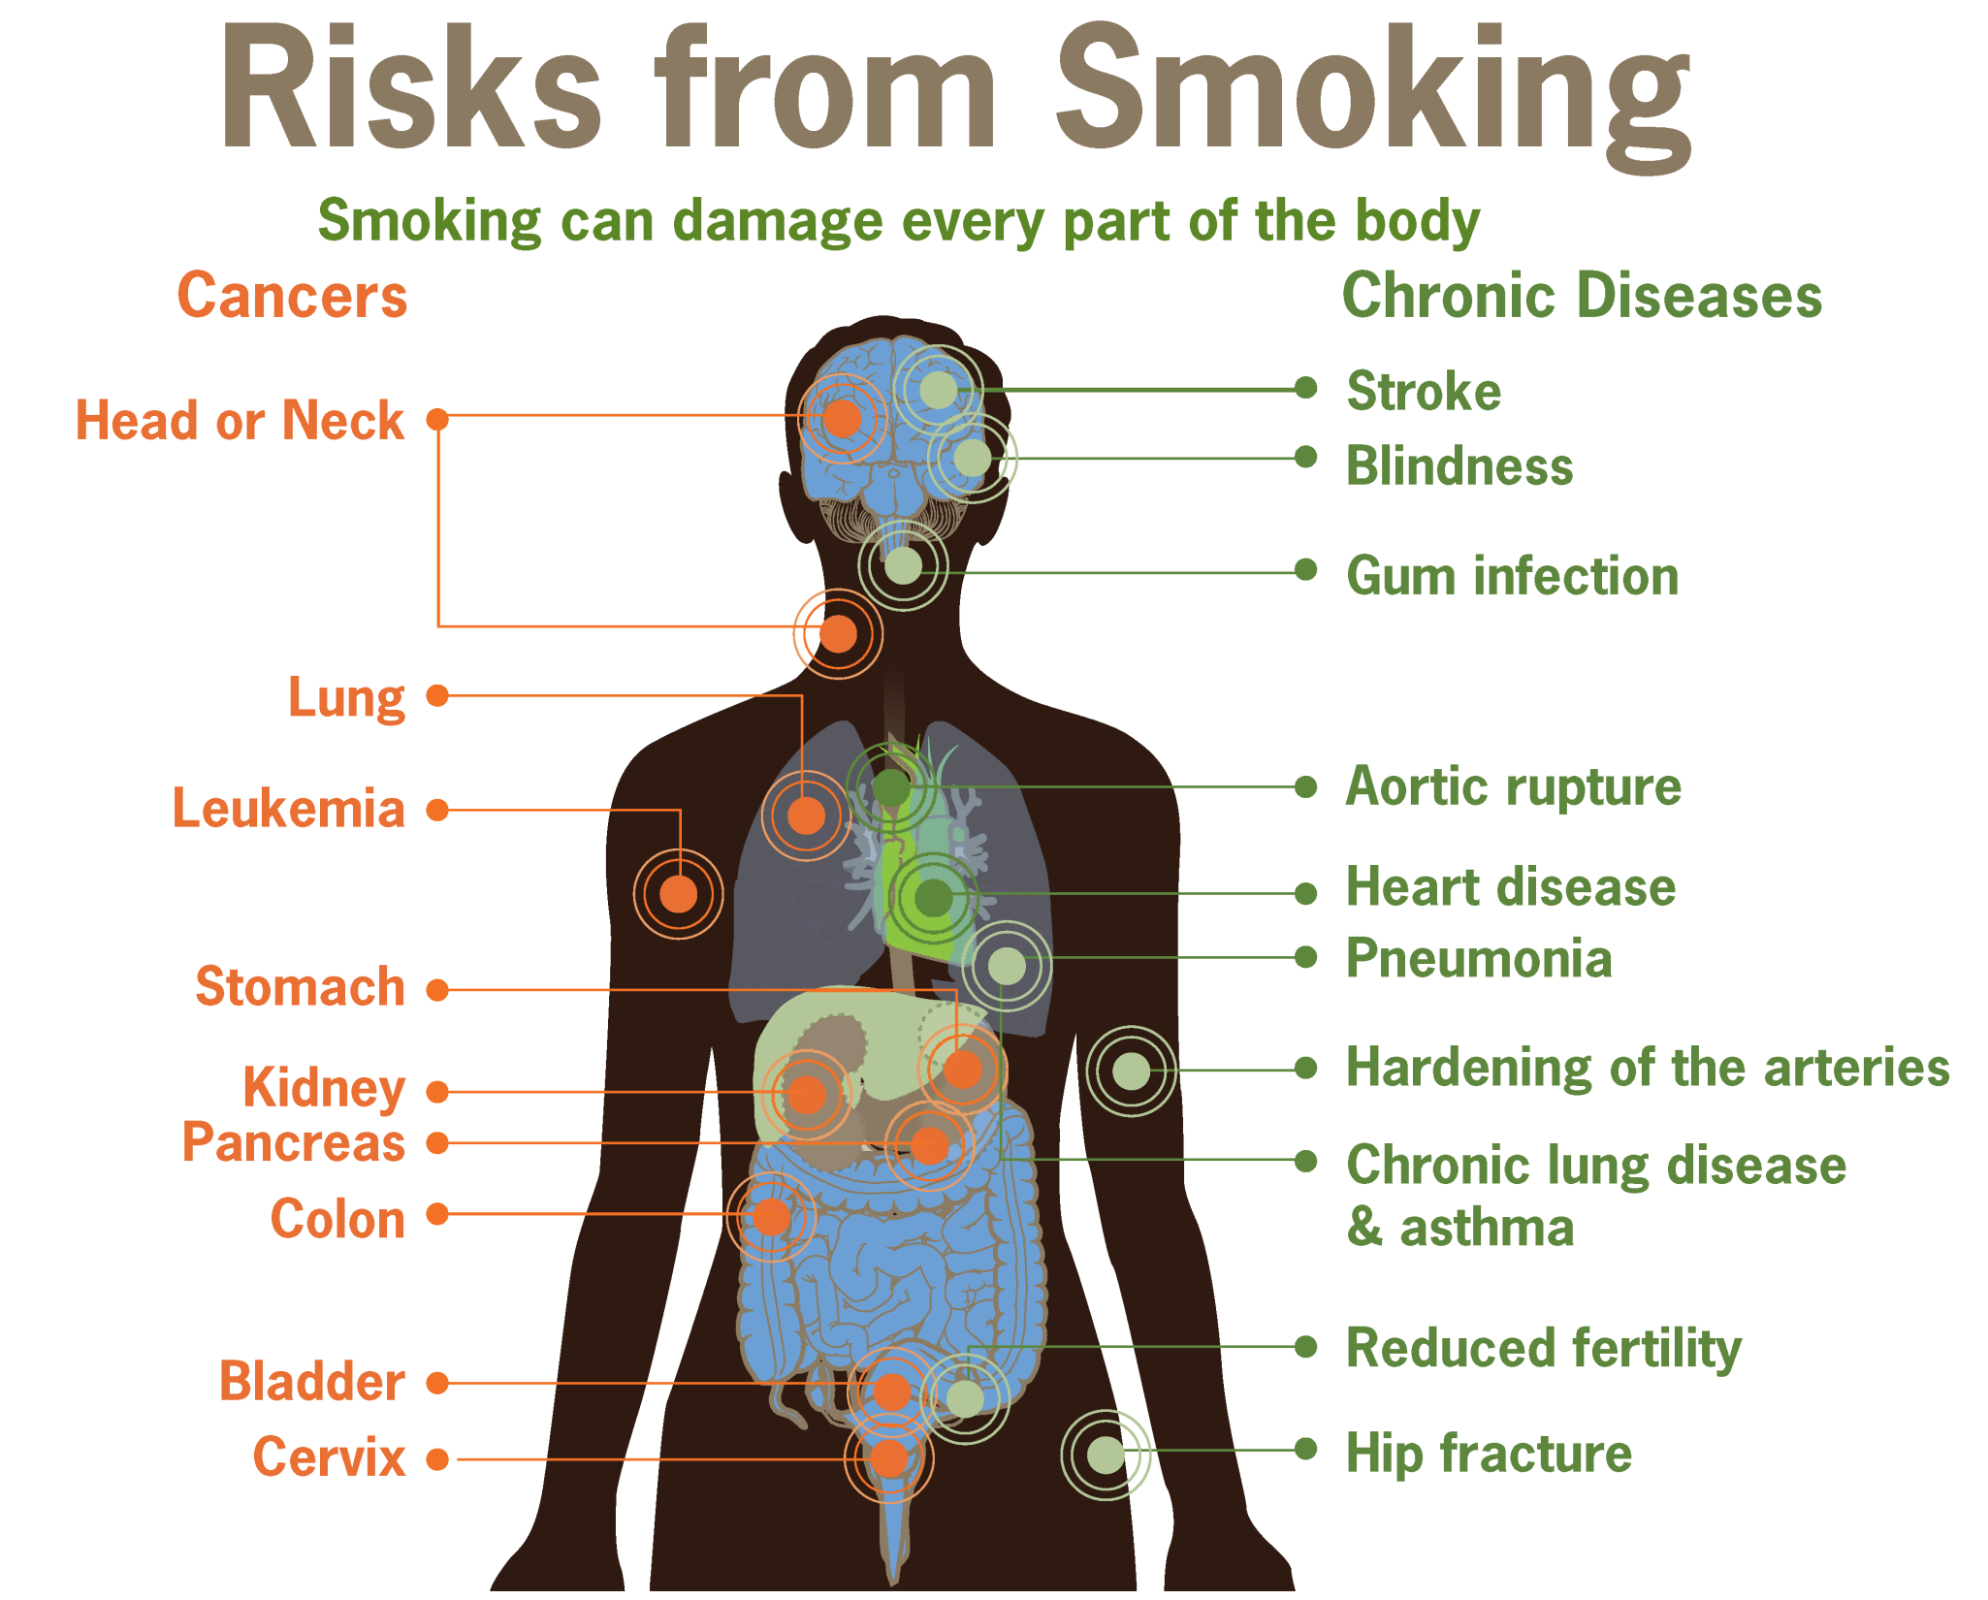

Slide 14
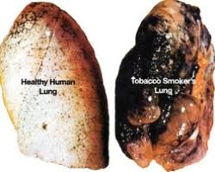
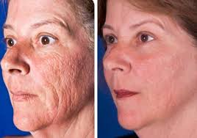
Smoking prematurely ages skin by between 10 and 20 years, and makes it three times more likely to get facialwrinkling, particularly around the eyes and mouth.
Smoking can cause fatal diseases such as pneumonia, emphysema and lung cancer. It causes 84% of deaths from lung cancer and 83% of deaths from chronic obstructive lung disease, including bronchitis.

Slide 15
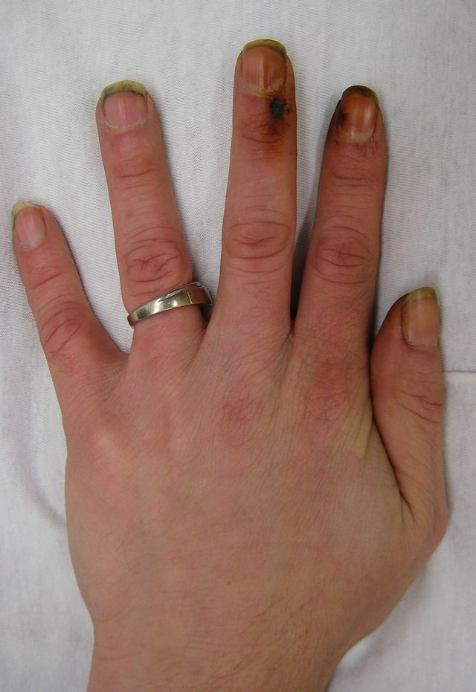
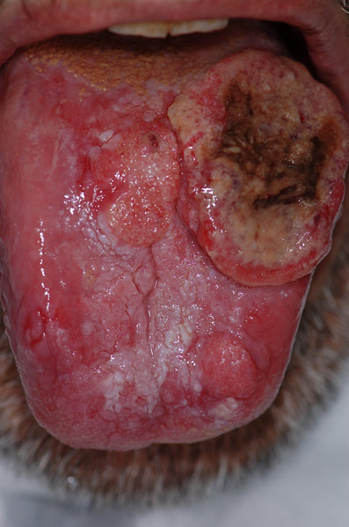

Slide 16
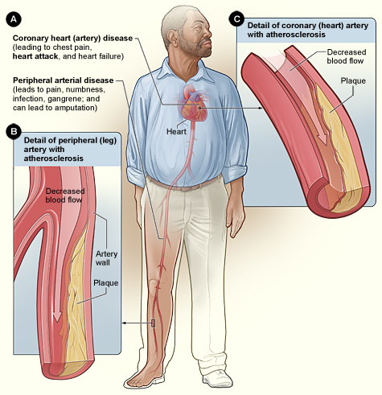

Slide 17
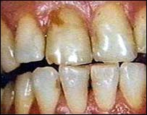
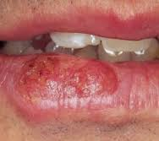
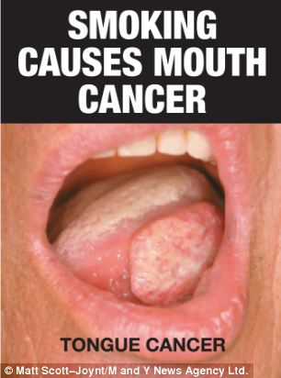
The most serious damage smoking causes in the mouth and throat is an increased risk of cancer in lips, tongue, throat, voice box and gullet (oesophagus). More than 93% of oropharangeal cancers (cancer in part of the throat) are caused by smoking.

Slide 18
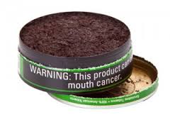
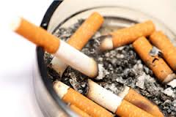
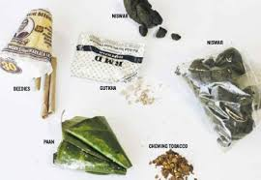
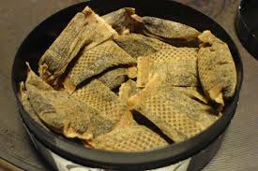
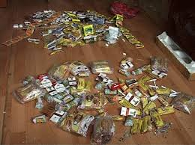
TOBACCO PRODUCT ADDICTION IN TEENAGE
Beedis, Chewing tobacco, Loose leaf, Pellets, Plug, Chillum,Cigars,Creamy snuff, Dipping tobacco, Hookah, Chutta smoking and reverse chutta smoking, Khaini, Gutkha,Paan with tobacco

Slide 19

ELECTRONIC ADDICTION
Internet Addiction, otherwise known as computer addiction, online addiction, or Internet addiction disorder (IAD)
Cybersex Addiction
Cyber-Relationship Addiction
Net Compulsions
Information Overload
Computer Addiction

Slide 20
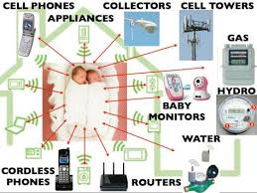

Slide 21
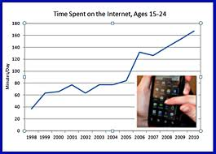

Slide 22
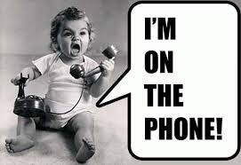


Risk factors for Internet or computer, mobile phone addiction
Anxiety
Depression
Other addictions
Lack social support
Unhappy teenager
Less mobile or socially inactive

Slide 23
Signs and symptoms of Internet or computer, mobile phone addiction
Losing track of time online
Having trouble completing tasks at work or home
Isolation from family and friends
Feeling guilty or defensive about your Internet use
Feeling a sense of euphoria while involved in Internet activities

Slide 24
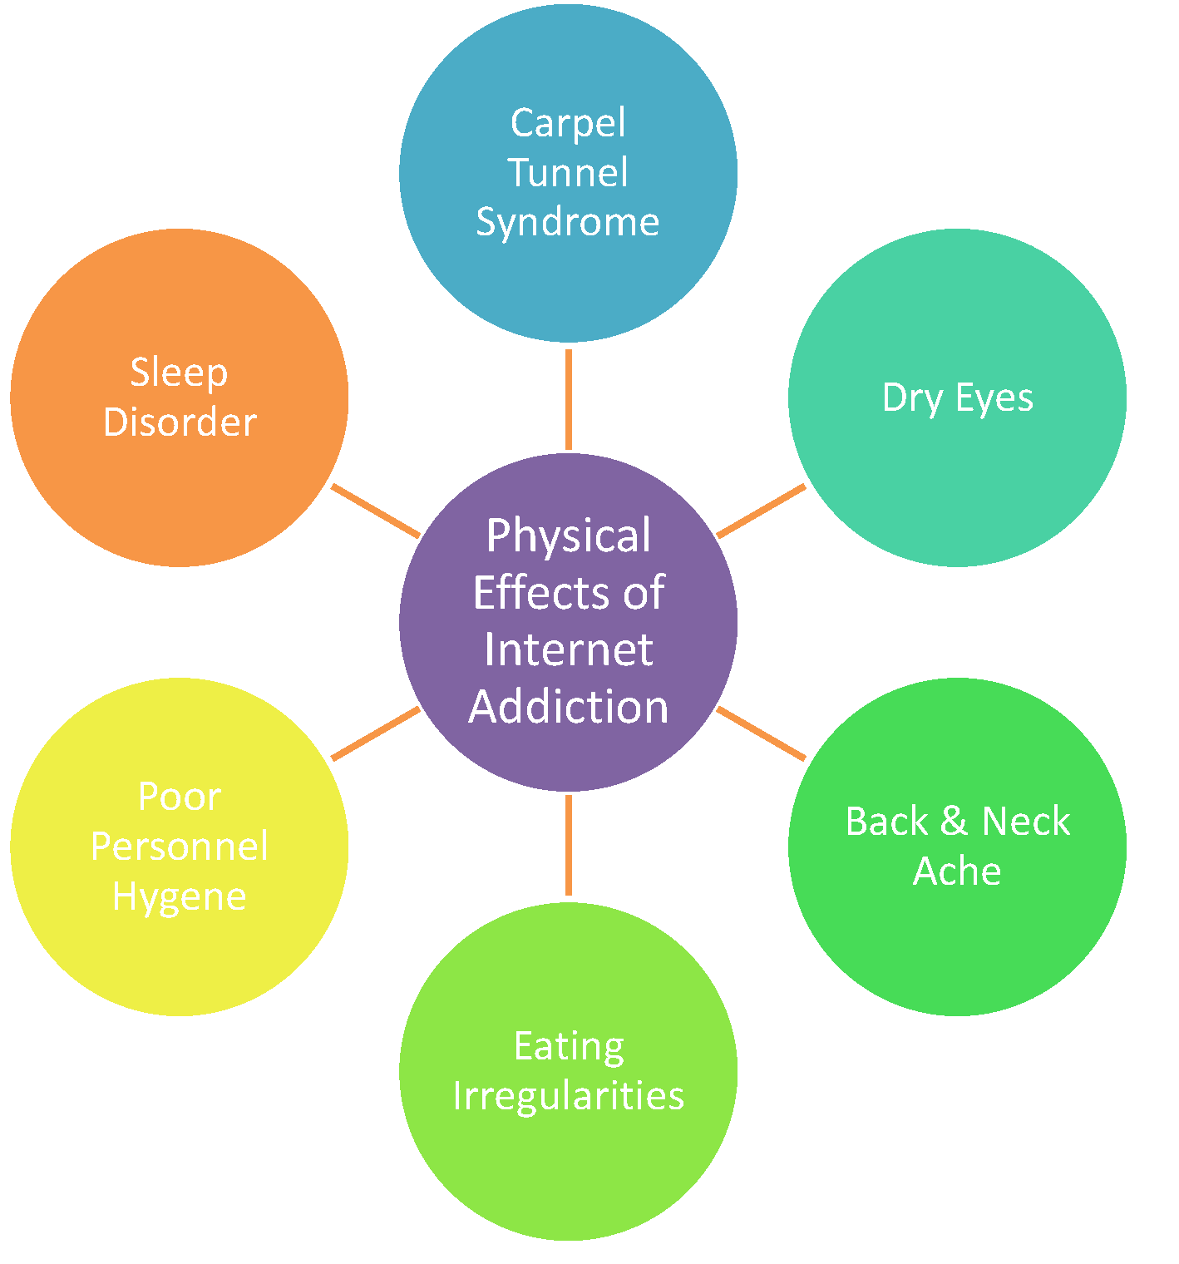
Physical symptoms of Internet addiction
Carpal Tunnel Syndrome (pain and numbness in hands and wrists)
Dry eyes or strained vision
Back aches and neck aches; severe headaches
Sleep disturbances
Pronounced weight gain or weight loss
Stress

Slide 25
